Slide 1
Sequence Diagrams
Gary King

Slide 2
What are Sequence Diagram’s for?
They are for showing step by step the interaction between the different parts of our program/system.
They are great for breaking down step by step the different parts of an program/system.
They explain expected results.
They explain how we expect to handler user input, and how the program/system creates output for the user.
Can be used to show errors, or multiple options for how input is handled

Slide 3
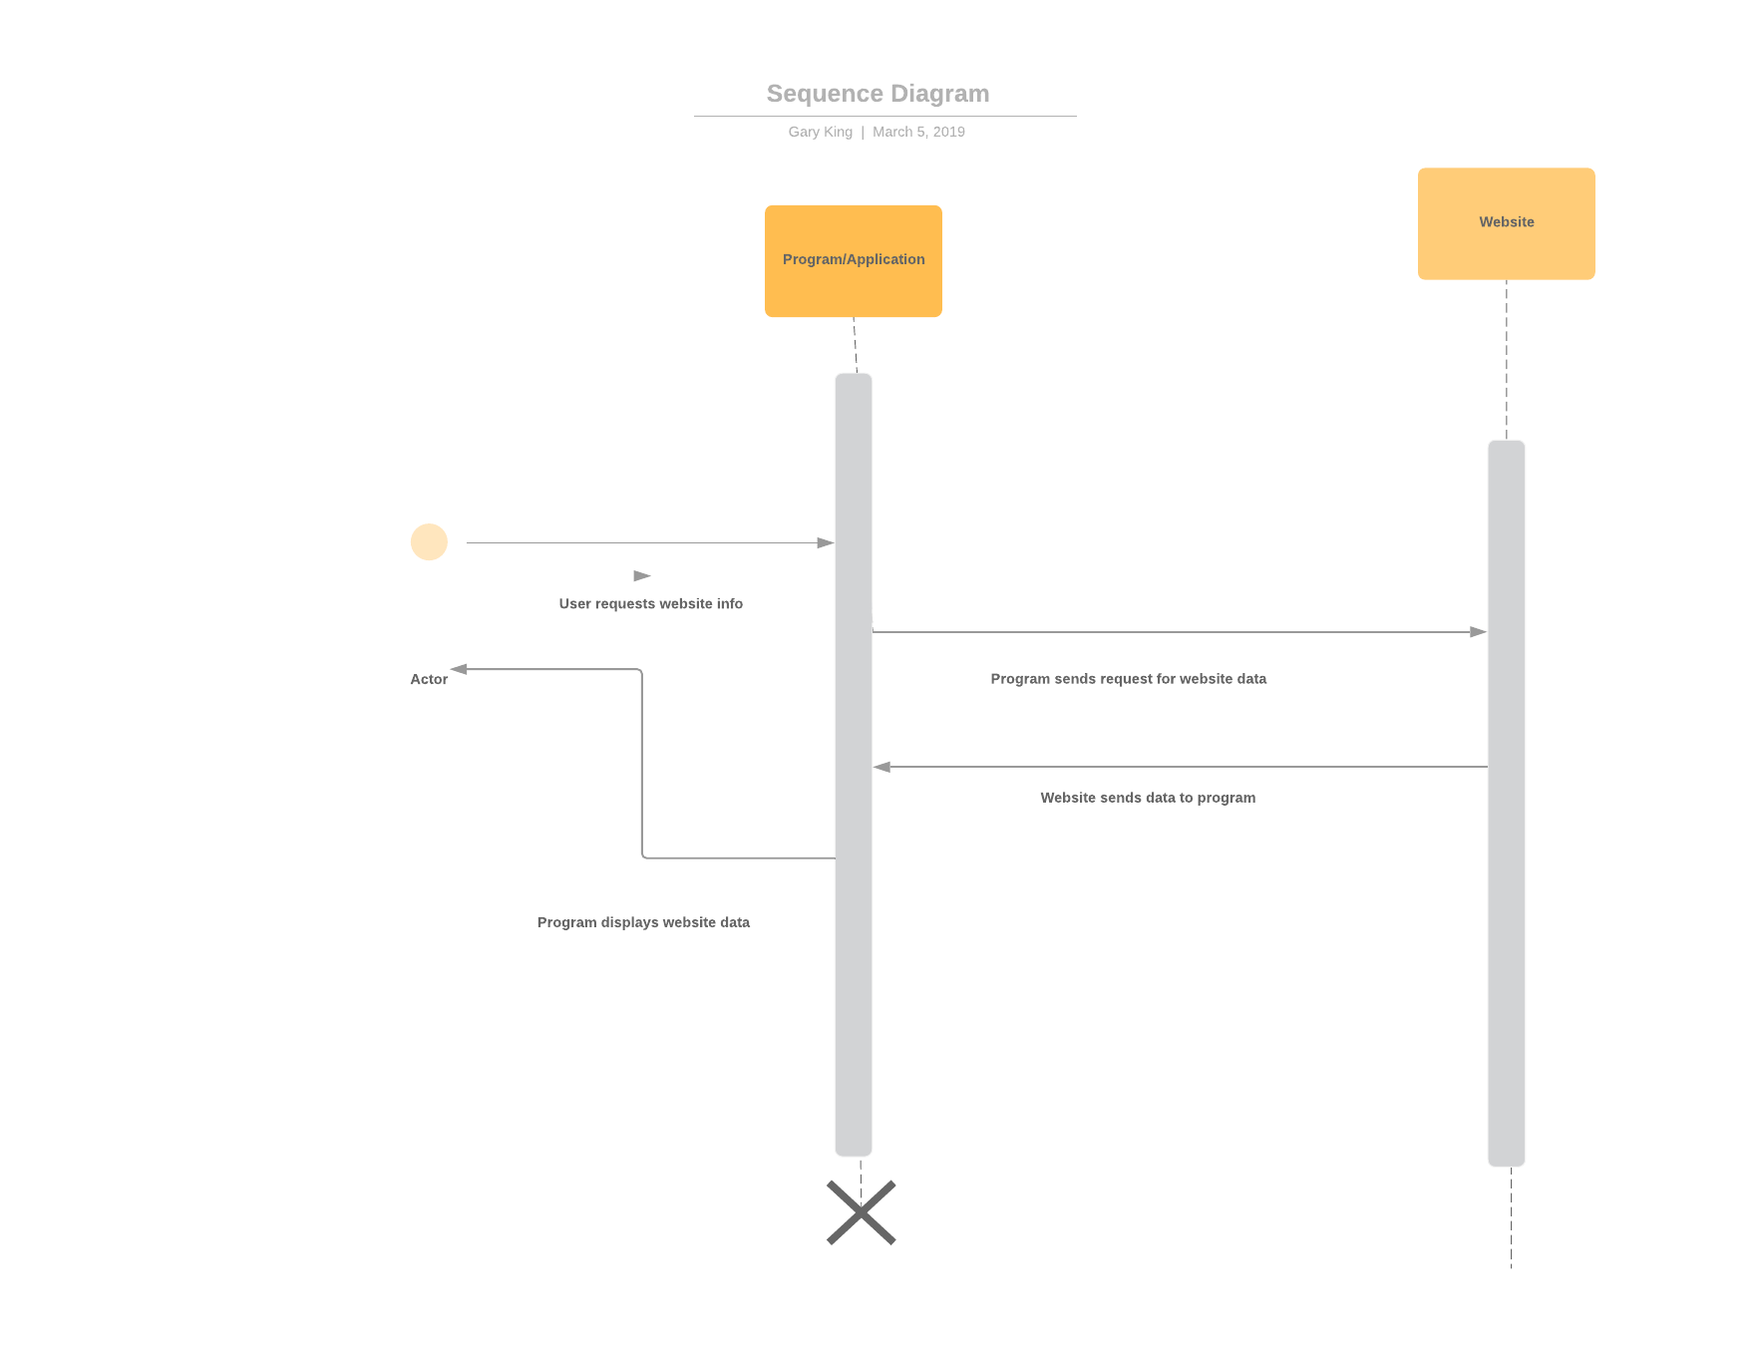
Example

Slide 4
Questions?

Slide 5
Sources
https://www.youtube.com/watch?v=pCK6prSq8aw
https://www.youtube.com/watch?v=18_kVlQMavE
https://www.lucidchart.com/documents/edit/ae7dc7de-e86e-4ef8-b8c8-f09cf3812300/0

